Slide 1
Welcome to P4/5 curriculum meeting

Slide 2
Literacy
Monday – Prim-Ed Spelling (focus on High Frequency Words)
Tuesday – Grammar & Punctuation
Wednesday – Shared/Reading
Thursday –Shared/Independent Writing
Friday - Comprehension
School Focus: Spelling / C2K Newsdesk

Slide 3
Reading
Currently carrying out Diagnostic Reading Tests - Recall, Reading Fluency & Comprehension Skills (Children grouped according to reading ages)
Guided Reading sessions weekly (depending on ability)
1 book from Bug Club every night
Bug Club –don’t read text for your child/ try not to answer
questions for them – I NEED to see if they are coping or struggling!

Slide 4
spelling scheme
Focus on High Frequency Words
and common everyday words.
Each child will have their own Personal HFW added to the core list of weekly spellings.

Slide 5
Numeracy
Place Value and Shape & Space (2D & 3D shape, symmetry, tiling)
Mental Maths – Four Rules/ Maths in Minutes/ Daily 10/ Memory Maths online
Number Bonds/ Times Tables
Mental Maths Listening Test
Problem Solving Activities –two per half term

Slide 6
World Around Us
Term 1: Great Fire of London
Term 2: Space
Term 3: Water

Slide 7
ICT
School Focus
Film & Animation

Slide 8
Children should:
read 1 book on Bug Club each night
complete 1 or 2 assigned tasks on Mathletics
complete nightly spelling practice
learn times tables facts

Slide 9
GROWTH MINDSET

Slide 10
Allergies/ dietary requirements
Please let school know if your child has any allergies or special dietary requirements, so we can inform the kitchen.

Slide 11
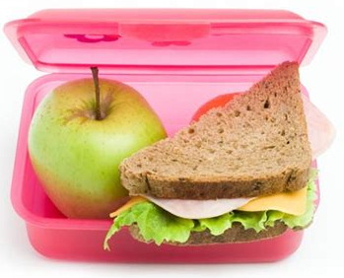
Healthy Lunch
Please try to ensure you child has a balanced lunch
– not too much chocolate/sweets!!
(Please note: your child should only have water or milk for breaktime)

Slide 12
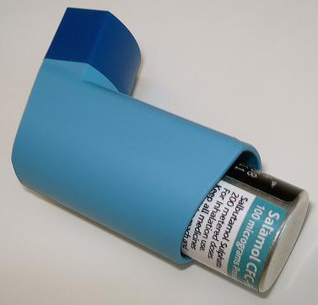
Medicines/Inhalers
Let staff member know what medicine your child needs. Remember, we need written consent.
If your child uses an inhaler, please ensure a full one is left into school and labelled with your child’s name.

Slide 13
Free School Meals
If you are entitled, please apply, even if your child doesn’t go to dinners.

Slide 14
SLEEP!!
Please try to ensure children get as much
sleep as possible.

Slide 15
Working Together

Slide 16
Thank you

