Slide 1
Primary 6/7 Curriculum Meeting
September 2020

Slide 2
P7 timetable
Mr Magee
Numeracy
Religion
Physical Education
Numeracy Problem Solving
Handwriting
Mrs Leitch
Literacy
Reading Activity
The World Around Us
PDMU
STEM
Phonics

Slide 3
Literacy Long term Plan – Mrs Leitch
Recount/Report:​
Macbeth- ​
Report on the murder of Banquo ​
Recounts from meeting with the witches ​
Newspaper plan ​
Poetry​
Exploring description in poetry and use of figurative language. ​
Robert Burns-My love is like a red, red rose. ​
William Blake-the Tyger ​
Christmas poetry, exploring rhyme. ​
Persuasive ​
Adverts/posters​
Debate
Narrative​
Children using story mountain and drama to plan their own myths and legends. Focus on using description to engage readers and transferring previous learning from poetry.​
Instructional/Explanation​
Inspired by topic linked to World Around Us ​
children to write up scientific experiment ​
Children to write up instructions on how to​
make a meal from a country explored during​
topic. ICT research to be used to plan. ​
Children to look at examples of good and bad instructions through practical activities of trying to follow them to develop success criteria for effective instructions. ​

Slide 4
Grammar​
Nouns/Proper Nouns/Pronouns​
Verbs/adverbs​
Adjectives/proper adjectives​
Conjunctions​
Sentence construction​
Subject/verb agreement​
Synonyms/antonyms​
Homonyms
Punctuation​
Capital letters/full stops​
Question/exclamation marks​
Commas​
Apostrophes​
Colon/semi-colon​
Quotation marks

Slide 5
Numeracy long term plan
Place Value
Addition, subtraction, multiplication and division.
Area and Perimeter
Shape 2d and 3d
Fractions
Percentages
Data Handling
Timetables
Measurements
Angles
Coordinates
Ratio
Probability
Algebra

Slide 6
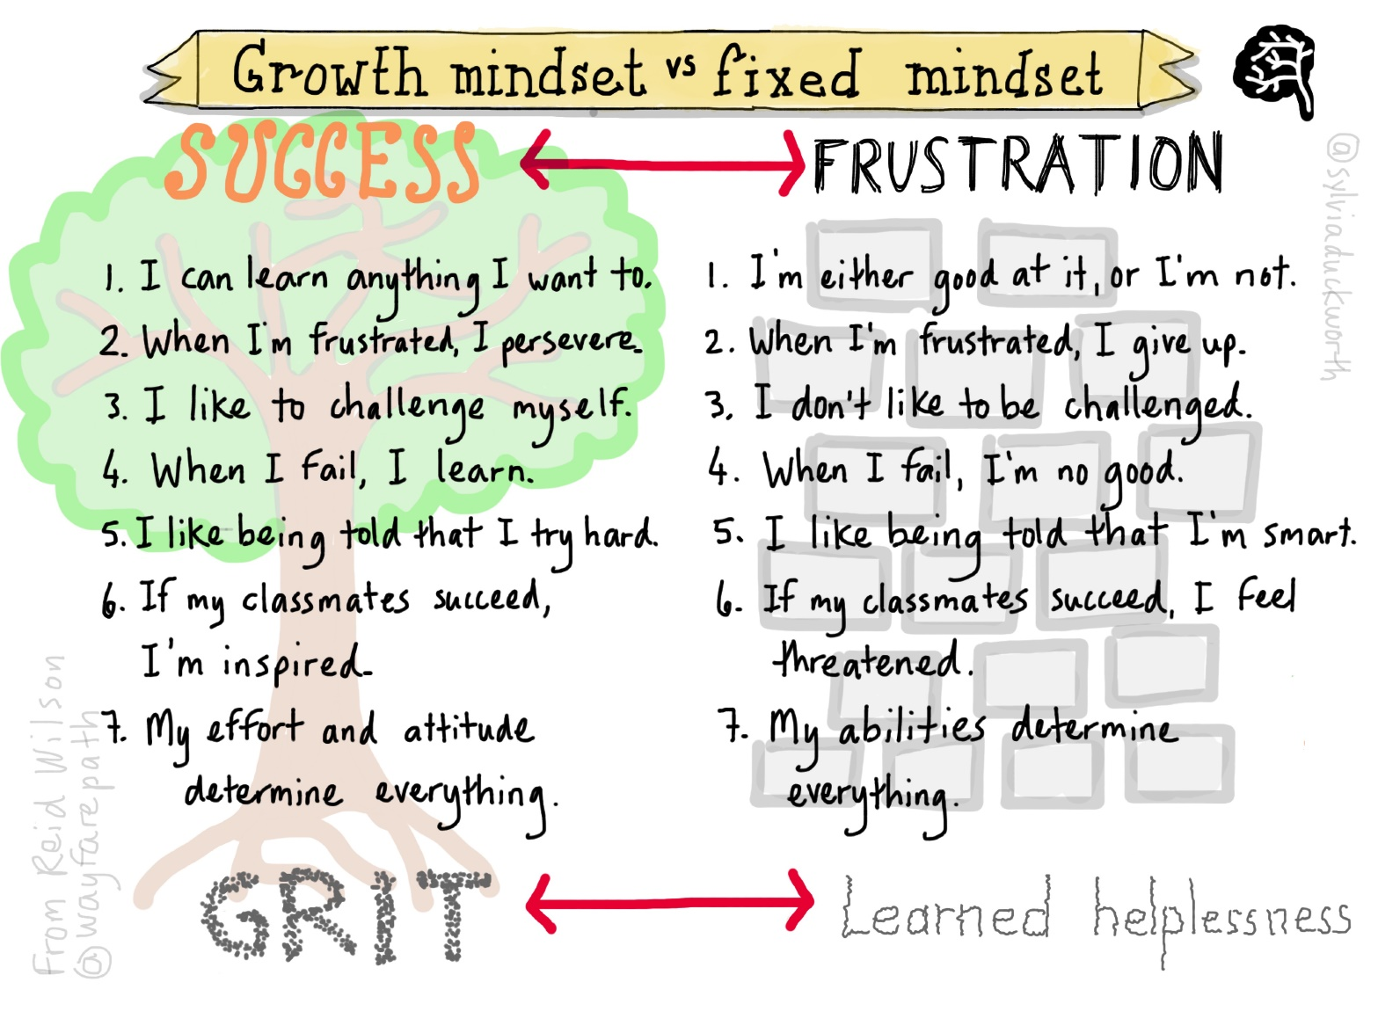
Growth Mindset

Slide 7

Homework
Each night (Monday – Thursday) pupils are expected to read on Bug Club.
Monday – Friday - Mathletics
Monday – Phonics
Tuesday – Comprehension
Thursday – Grammar and Punctuation

Slide 8
Mathletics
Numeracy homework will be on Mathletics. Pupils will be assigned tasks on a Monday to be completed by a Friday. The tasks will be a revision of the previous week’s learning.
Please download the app for ease of use.

Slide 9

Bug Club
Pupils should read every Monday – Thursday night and answer the comprehension questions associated with the text.
Where possible pupils should read on a laptop or tablet and not a phone.
Cookies should be enabled and pop-ups allowed.

Slide 10

P.E
P. E will take place each Thursday afternoon.
Please ensure that pupils wear their sports gear to school each Thursday with a few extra layers as well.

Slide 11

See-Saw
Please ensure you download the See-Saw app as a means of communication and away of seeing your child’s learning.

Slide 12
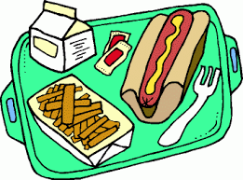
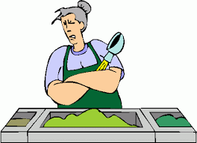
Allergens/Special Diet
Please make us aware if your child has any allergies or requires a special diet.

Slide 13

NUT FREE SCHOOL
We are a NUT FREE SCHOOL, snack/lunch boxes should NOT contain any food items that contain traces of nuts.

Slide 14
School Money
School Money have released an app to make for ease of paying for clubs etc.

Slide 15

Education Authority - FSM
If you feel that you would be entitled to free schools meals please contact the school for the appropriate forms. Even if it would not be your intention at this stage for your child to avail of the free school meals and uniform to which they are entitled, it is still important that you register your entitlement as soon as possible.

Slide 16
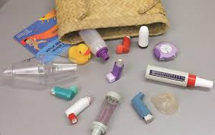
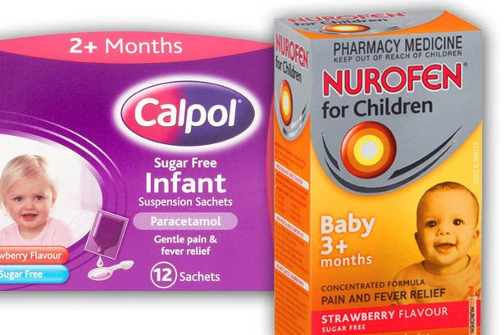
Medicine/Inhalers
Please ensure that we have in date inhalers and any other medication that your child might need.

Slide 17

Residential Trip – P7
Provisionally booked –24th, 25th and 26th May 2021

Slide 18
School Website/App
Please download the school app and ensure that you check the website on a regular basis.

Slide 19
Child Protection
Child Protection
All relevant policies are on the school website and available to download.

Slide 20
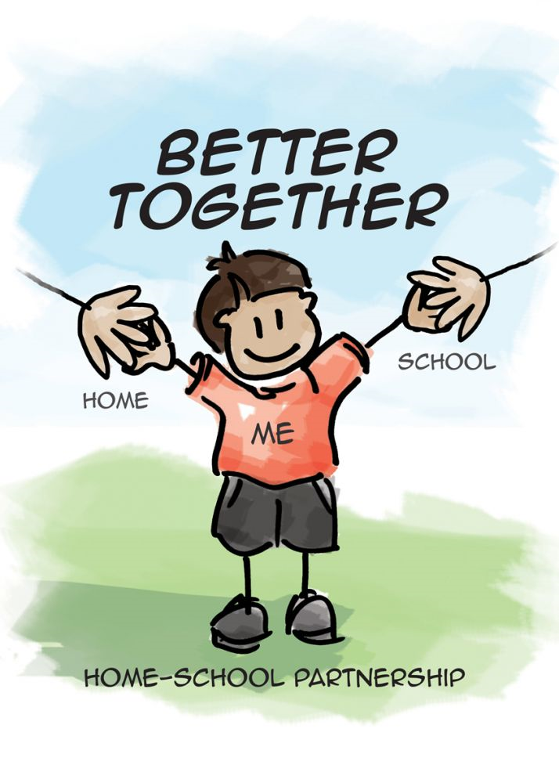
A partnership

