Slide 1
Primary 1
Curriculum Meeting
Friday 11th September 2020

Slide 2
P1 timetable
Mrs McIvor
* Play Based Learning
Numeracy
Religion
Physical Education
Numeracy Problem Solving
Handwriting
Reading Activity
The World Around Us
PDMU
Phonics

Slide 3

Literacy Long term Plan

Slide 4
St. Francis’ Primary School, Drumaroad
P1 Literacy Yearly Overview
Yearly Overview Academic Year: 2020-21 |  | Genre | Planned Writing Activities | Cross Curricular Links: World Around Us Topics
Term One | Autumn 1 September - October 2020 | Poetry/ procedural Ourselves Procedural Hallowe’en (Geog/Hist) | Poems about ourselves and our families. Rhyming words activities etc. Rhyming words activities etc. Writing instructions on how to make a witch’s hat, how to make pumpkin soup. Writing a spell for a witch or wizard. | Ourselves, Our 5 senses: Sight, Hearing, Taste, Touch, Smell Parts of the body. Light and dark/ Halloween.
 | Autumn/Christmas 2 November - December 2020 | Explanation Writing/ Procedural. Polar Lands, People and Animals ( Science/ Geog) Letter writing | Write experiment on heating and cooling. Explain why people and animals wear certain materials/ coats in polar conditions. Compare to clothes, animals, and conditions here and explain differences. Writing a letter to Santa. | Where are the polar lands on the map/globe/ atlas? Why are they covered in ice and snow? How does water turn to ice and vice versa. Materials for heat, waterproofing etc. PDMU, look at cultural differences.
Term Two | Spring 1 January - February 2021 | People who help us (History) | Narrative Writing Create a story about a character who helps us. The class will collate their stories and ideas to create a story book | Light and darkness, the sun as a source of light. Light from electricity, things that use electricity. Characters from history who have helped us.
 | Spring 2 March - April 2021 | Report Minibeasts (Science) | Writing about different animals, how and why farmers keep these animals, How wheat is grown and bread is made tec.
Term Three | Summer 1 May-June 2021 | Exposition Wind, Weather and Superheroes (Geography/History) | Writing comic book stories about super heroes. Looking at characters, beginning, middle and ending of stories etc. | Flight, animals and machines that fly. Using wind power to aid flight.
 | Summer 2 | Exposition and recap of other forms of writing Summer/The seasons (Geography) | Posters advertising Summer holiday destinations. | Weather and the changing seasons, summer clothes, plant

Slide 5

Numeracy Long term plan

Slide 6
St. Francis’ Primary School, Drumaroad
P1 Numeracy Yearly Overview
Term 1
 | P1 | Mrs McIvor | Numeracy |  | Yearly Planner | 2020/2021
Month | Number | Mental Maths | Shape & Space | Handling Data | Measures | Processes | Problem Solving
Sept | P1. Counting Rhymes Counting Activities Stories Understand that 0 means none Create simple repeating patterns Continue a simple pattern SMPG Maths Book ½ NHM Level R One to one correspondence Number: 0, 1 Become familiar with the Numicon pieces, experiment with them and see how the pieces fit together. | Daily Basis: P1 Counting 1 – 10 Counting 10 - 1 Doubles to 10 1 after 1 before Placement of numbers in a number line. Counting in 2s, 5s and 10s. Doubling and halving numbers to 10. Number bonds to 10 rhyme. | Introduce and investigate informally through structured play. | Sorting Activities-for one criteria Colour/shape/size Bar Chart – favourite colour Eye colour Hair colour Gender Look at Venn and Carroll diagrams and sorting according to different criteria. | Introduce and investigate informally through structured play. Sand and Water activities with jugs, cups, buckets etc through Structured play Area: Begin to understand the concept of area as the idea of covering a surface eg the table cloth covers the table | Introduce and investigate informally through structured play. Settling in period. General sorting, matching and classifying activities. | Making towers Foundation stage, Finding all possibilities
October | Number: 2, 3, 4, 5 Sorting/matching activities Conservation of number Recognising Numerals Make sets of numbers up to 3 Have a feel for a set of objects up to 3 SMPG Maths Book 2 NHM R | Daily Basis: Counting 1 – 10 Counting 10 - 1 Doubles to 10 1 after 1 before Placement of numbers in a number line. Counting in 2s, 5s and 10s. Doubling and halving numbers to 10. Number bonds to 10 rhyme. | To investigate informally through structured play. Follow instructions for movement along a line: Forwards, backwards, sideways ( Link with outdoor play and PE) | Carroll/Venn Diagrams Negation Opportunities to consolidate learning through Structured play activities. | Capacity/Volume Link to Water tray during structured play. Language: Pour/Fill Holds More/Less Full/Empty Using 1L Comparisons of Containers | Solve problems based on stories. Understand and use mathematical language. Talk about how a task could be approached. | Teddy Town Foundation stage, Finding all possibilities. Arranging Compare Bears Foundation stage, Finding all possibilities.
Nov | Number: 6, 7, 8, 9 Sorting/matching activities Conservation of number Recognising Numerals Make sets of numbers up to 7 Have a feel for a set of objects up to 7 SMPG Maths Book 2/3 | Daily Basis: Counting 1 – 10 Counting 10 - 1 Doubles to 10 1 after 1 before Placement of numbers in a number line. Counting in 2s, 5s and 10s. Doubling and halving numbers to 10. Number bonds to 10 rhyme. |  | Tally Chart – Favourite shapes | Capacity/Volume Link to Water tray during structured play. Language: Pour/Fill Holds More/Less Full/Empty Using 1L Comparisons of Containers | Understand and use mathematical language Use mathematical materials in the classroom/role play | Smartie Maths, Foundation Stage Exploring partterns. Goldilocks goes fishing, Exploring Patterns.

Slide 7
Term 2
Dec | Number: 10 Sorting/matching activities Conservation of number Recognising Numerals Make sets of numbers up to 10 Have a feel for a set of objects up to 10 SMPG Maths Book 2/3 | Daily Basis: Counting 1 – 10 Counting 10 - 1 Doubles to 10 1 after 1 before Placement of numbers in a number line. , counting in 2s, 5s and 10s. Doubling and halving numbers to 10. Number bonds to 10 rhyme. |  | Block Graph- Christmas presents | Patterns Sequencing 2/3 events Language: next, before, after, in between Link to Literacy Comprehension activities. | Understand and use mathematical language Use mathematical materials in the classroom/role play | Can I Pass. Exploring patterns.
January | Combine sets of objects to find how many Sequencing of Numerals within 10 Combine sets of objects to find out how many Explore addition patterns up to 10/20 and above P1 Addition of single digits Function Machines. Differentiate according to ability. | Daily Basis: whole class Counting 1 – 20 Counting 20 - 1 As above 1-20, counting in 2s, 5s and 10s. Doubling and halving numbers to 20. Number bonds to 10 rhyme. | Looking at properties of: Square Circle Rectangle Triangle Looking at shapes in the environment. Drawing pictures made from shapes. Looking at properties of: Oval Sphere Cube Cuboid | Use mapping diagrams to show relationships between members of two sets. | Time Talk about events now, past and future Language; Now, later, soon, Morning, evening, yesterday, Before, after, day, night Know names of: Seasons /Months/Days Month of birthday Class Daily Calender | Understand and use mathematical language-names of 2D/3D Shapes Record simple investigations | Apples for the three pigs. Exploring patterns. Delivering milk bottles. Exploring pattrens.
February | Sequencing of Numerals within 10 Combine sets of objects to find out how many Explore addition patterns up to 10 Addition of single digits Function Machines P1 Addition of single digits Function Machines. Differentiate according to ability. | Daily Basis: Whole class Counting 1 – 20 Counting 20 - 1 As above 1-20, counting in 2s, 5s and 10s. Doubling and halving numbers to 20. Number bonds to 10 rhyme. | Positional Language: Over, under, beside, behind, backwards, full turn Looking at properties of: Cone Triangular prism Explore movement through space. Look at Bee Bot and Trudy’s Time and Place (The Jelly bean eating ant). Opportunity to talk about North, South, East and West. Up, Down, Forward, backwards, right and left. |  | Time Talk about events now, past and future Language; Now, later, soon, Morning, evening, yesterday, Before, after, day, night Know names of: Seasons /Months/Days Month of birthday Class Daily Calender Develop understanding of time by: Time: O’clock Half past One hour before and after a given time. Important times during the day, time to get up, school starts at, break time, lunch time, home time, dinner time, bedtime. | Understand and use mathematical language: Plus, more than, add, one more, plus, after | Beebot Moves Finding all possibilities Make a Snake Lollipops

Slide 8
Term 3
March | Subtraction Money Recognise coins: 1p, 2p, 5p, 10p, 20p, 50p, £1, £2. Know how many 1ps, 10ps 20ps and 50ps make up £1. Shopping Activities using 1p and 2p in context of play. Using coins up to 10p, begin to work on change. Continue addition | Daily Basis: Whole class Counting 1 – 20 Counting 20 - 1 Doubles to 20 Counting in 2’s to 20 Subtracting in 1’s/2’s As above 1-20, counting in 2s, 5s and 10s. Doubling and halving numbers to 20. Number bonds to 10 rhyme. | Consolidate learning through structured play activities. | Pictograph: Types of Minibeasts found during Mini beast hunt/safari | Predictions Area: Compare and talk about two surfaces by placing one on top of the other | Understand and use mathematical language: Subtract, less than, take away, minus, before | Dinosaur Eggs Finding all possibilities. Four Pin Bowling, Finding all possibilities.
April | Money Recognise coins: 1p, 2p, 5p, 10p, 20p, 50p, £1, £2 Know how many 1ps, 10ps 20ps and 50ps make up £1. Shopping Activities using 1p and 2p in context of play. Work with coins up to 20p. Calculate change. Continue addition and subtraction. | Daily Basis: Whole class Counting 1 – 20 Counting 20 - 1 P2 As above 1-20, counting in 2s, 5s and 10s. Doubling and halving numbers to 20. Number bonds to 10 rhyme. | 3D Shape Revision of Sphere, Cube, Cuboid, Cone, Pyramid | Bar Chart: Sorting Money | Weight: Language: Heavy/Light Heavier/Lighter Same As/Lightest Compare 2 objects by handling/scales Order objects of 3 different weights Using 1kg | Understand and use mathematical language Add/subtract/minus/more than/less than/before/after /doubles/ | Sort out the faces. Foundation stage, Exploring pattrens.
May | Understand and use Ordinal Terms 1st, 2nd, 3rd, etc Continue addition and subtraction. | Daily Basis: Whole class Counting 1 – 20 Counting 20 - 1 P2 As above 1-20, counting in 2s, 5s and 10s. Doubling and halving numbers to 20. Number bonds to 10 rhyme. | Making plants and flowers, pots etc using 2d shapes. Use pieces of felt and cut into shapes include ovals and diamonds etc to create gardens etc. | Tally Chart: Types of plants in the garden. Favourite colours of flowers. | Length Language: Short/Long Shorter/Longer Same Length Taller/Tallest Handspans/Using 1m stick Comparison of two objects Order objects of 3 different lengths Addition: Add, Plus, More than, Add on, Jump on, Altogether Subtraction: Subtract, Minus, Less than, Take away, Jump back | Understand and use mathematical language | Make your own caunting stick. Exploring patterns. Number steps Exploring patterns.
June | Continue addition and subtraction. | Daily Basis: Whole class Counting 1 – 20 Counting 20 - 1 Doubles to 20 Counting in 2’s to 20 Adding on in 1’s/2’s Subtracting in 1’s/2’s Counting in 5’s | Make a weather vane. | Pictograph: Recording weather on charts over three weeks. | Addition: Add, Plus, More than, Add on, Jump on, Altogether Subtraction: Subtract, Minus, Less than, Take away, Jump back |  | Towers of three, Exploring patterns. Gold Bars/ Five pin bowling, Finding all possibilities.

Slide 9
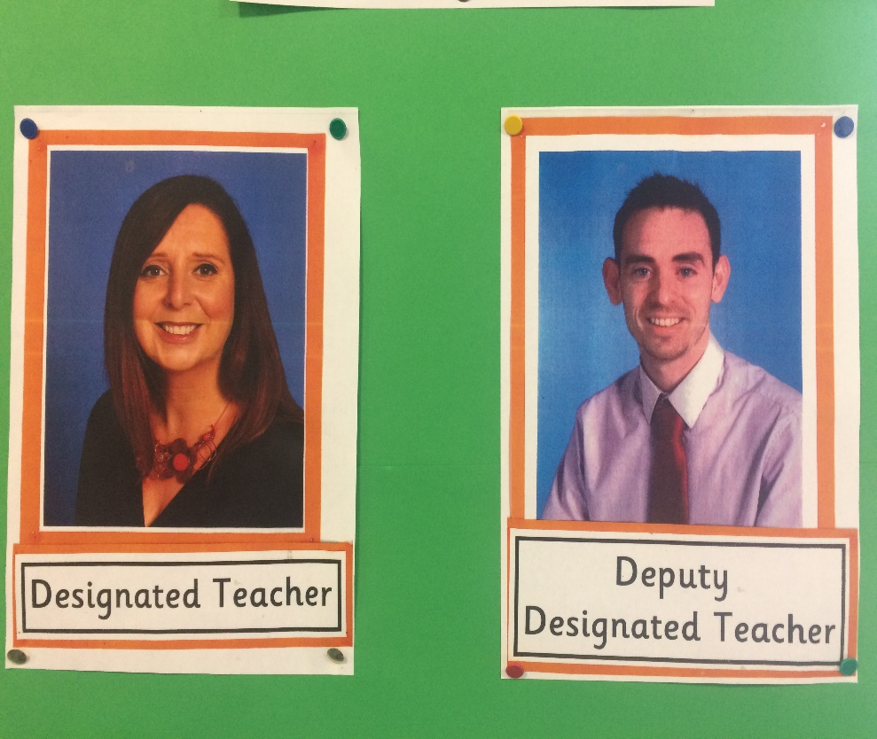
Child Protection and Safeguarding
Child Protection and Safeguarding are our number one priority at St. Francis’ Primary School.
The Child protection team consists of Mrs McIvor ( Designated Teacher) and Mr Magee ( Deputy Designated Teacher). Their photos are displayed in every building throughout the school.
The children are regularly reminded through circle time, class discussions and assemblies about the importance of feeling happy and safe at school and at home. They are also reminded of who they can approach if they feel unhappy, concerned or anxious. The Child Protection and Safeguarding policies are available to view on the school website.

Slide 10

Bug Club
Bug Club is a fun online reading scheme which is used as a supplementary tool to our main reading scheme in school. The children will be provided with books which they can access at home to develop their reading and comprehension skills.
They can have fun answering questions and earning gold coins which they can exchange for online rewards.

Slide 11
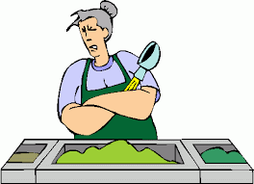
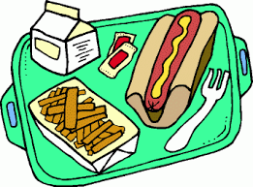
Allergens/Special Diet
We are a NUT FREE SCHOOL, snack/lunch boxes should NOT contain any food items that contain traces of nuts.

Slide 12

Education Authority - FSM
If you feel that you would be entitled to free schools meals please contact the school for the appropriate forms. Even if it would not be your intention at this stage for your child to avail of the free school meals and uniform to which they are entitled, it is still important that you register your entitlement as soon as possible.

Slide 13
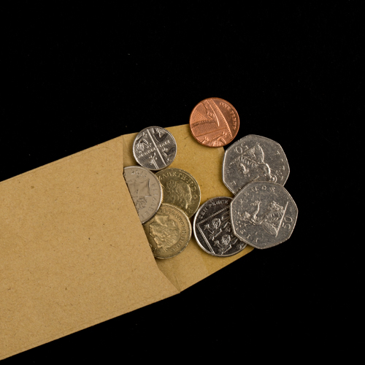
Please ensure all money payments are made online through the school Money Website
Money

Slide 14
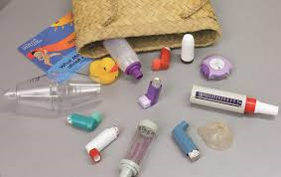
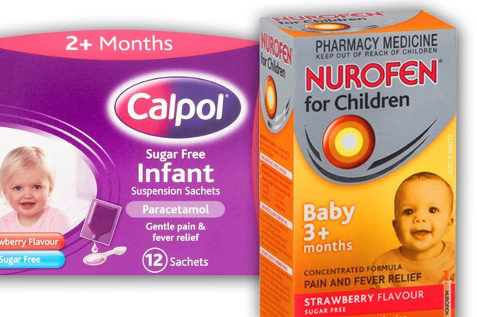
Medicine/Inhalers
Please ensure that essential medication such as inhalers, epi pens are sent into school and clearly labelled with your child’s name.

Slide 15
School Website/App

Slide 16
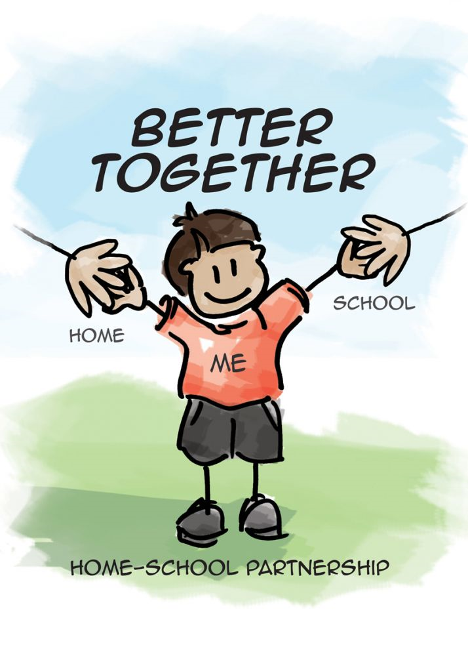
A partnership

